Slide 1
ESP 8266
Workshop
VERDANA

Slide 2

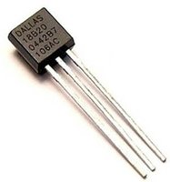
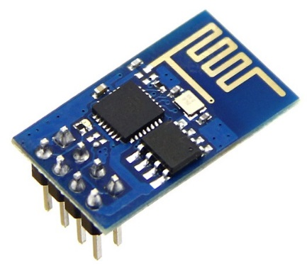
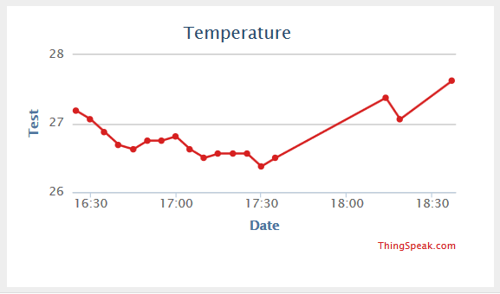

Aim for Today
°C

Slide 3
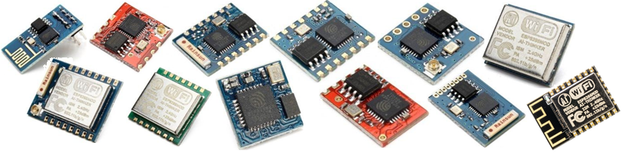
ESP 8266
32 bit CPU with GPIO ports and WiFi
GPIO = general-purpose input/output
CPU: 80 MHz
Memory: 512kB – 4 MB
Programing languages: C, Lua, MicroPython
ESP 32 is a successor of ESP 8266
Dual core, WiFi + Bluetooth

Slide 4
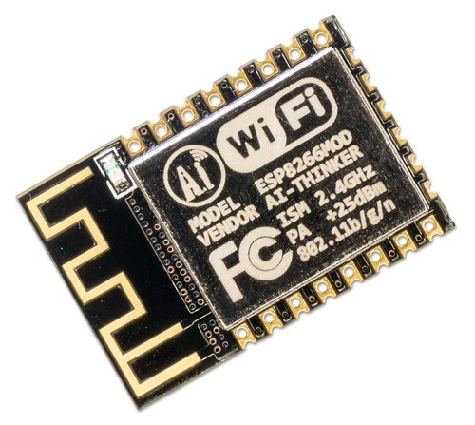
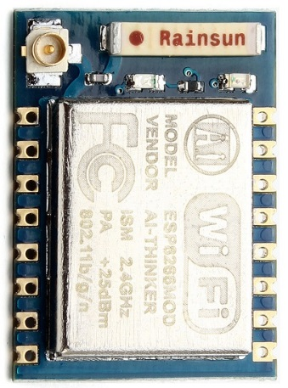
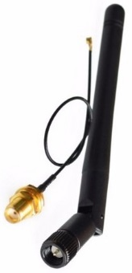
ESP 8266 | Recommended Types
ESP-01 | ESP-12e/f | ESP-07
Small 512 kB memory 2 GPIO Integrated antenna | Soldering needed 4 MB memory 17 GPIO (half with predefined purpose) Deep sleep mode Integrated antenna | Similar to ESP-12 Soldering needed 4 MB memory 9 GPIO (half with predefined purpose) Deep sleep mode External antenna needed

Slide 5
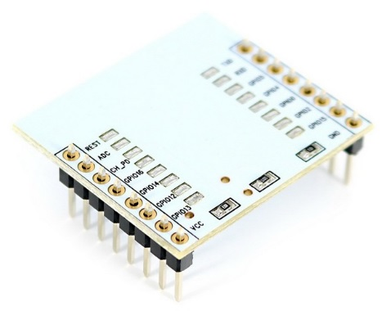
Shopping List 1/3
ESP 8266 | ESP-01 | ESP 8266 | ESP-12e / 12f | ESP-12 adapter
4 GPIO 512 kB memory WiFi | 17 GPIO 4 MB memory Pin for wake up from deep sleep WiFi | Suitable for ESP-12e/f Adapter for ESP-12e/f not available yet → some pins not connected.
1.65 USD | 1.80 USD 2.70 USD (with adapter) | 0.65 USD
Can be ordered on: https://www.aliexpress.com/ Prices include shipping.

Slide 6
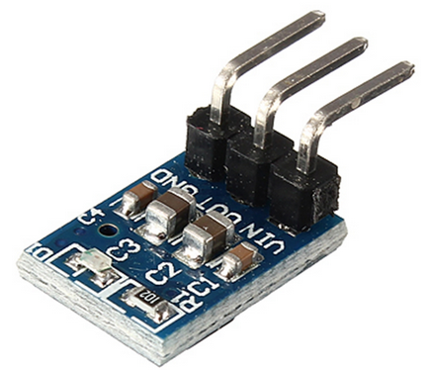
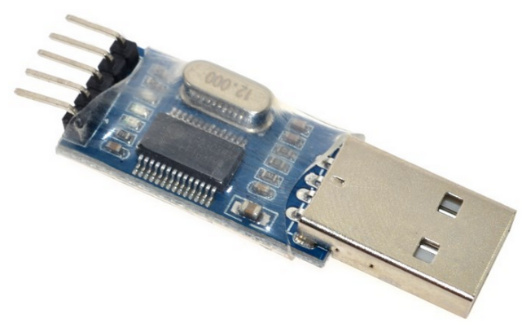
Shopping List 2/3
PL2303 | 5v to 3.3v AMS1117 | DS1820
USB to TTL To communicate (program and flash) with ESP from PC. | DC-DC Step-Down Power Supply Buck Module AMS1117 800mA One for each ESP. | Temperature sensor. It is possible to connect more than one over one wire to the ESP.
0.65 USD | 2.70 USD / 10 pieces | 8.50 USD / 10 pieces 5.90 USD / 5 pieces
Images are not in comparable scale.

Slide 7
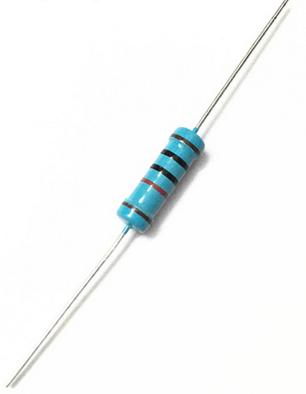
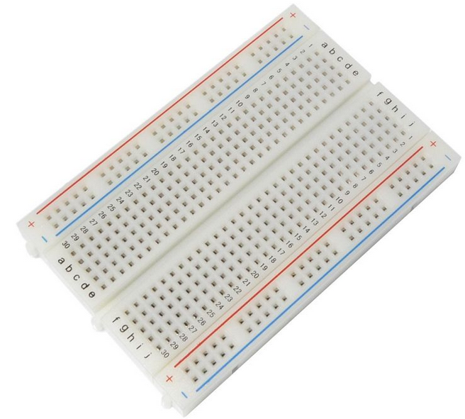
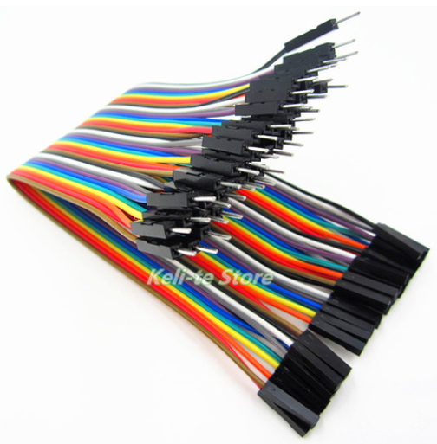
Shopping List 3/3
4,7 k Ohm resistor | Breadboard | Row Dupont Cable
One for each connected DS1820. Buy in GM Electronic (Pilsen), or another electronic shop. | Place to plug all pieces in and connect with wires. | Wires to connect all pieces together. Buy two types: male-to-male and male-to-female.
~ 0 USD | 1.10 – 5.00 USD (depends on size) | 1.00 USD
Images are not in comparable scale.

Slide 8
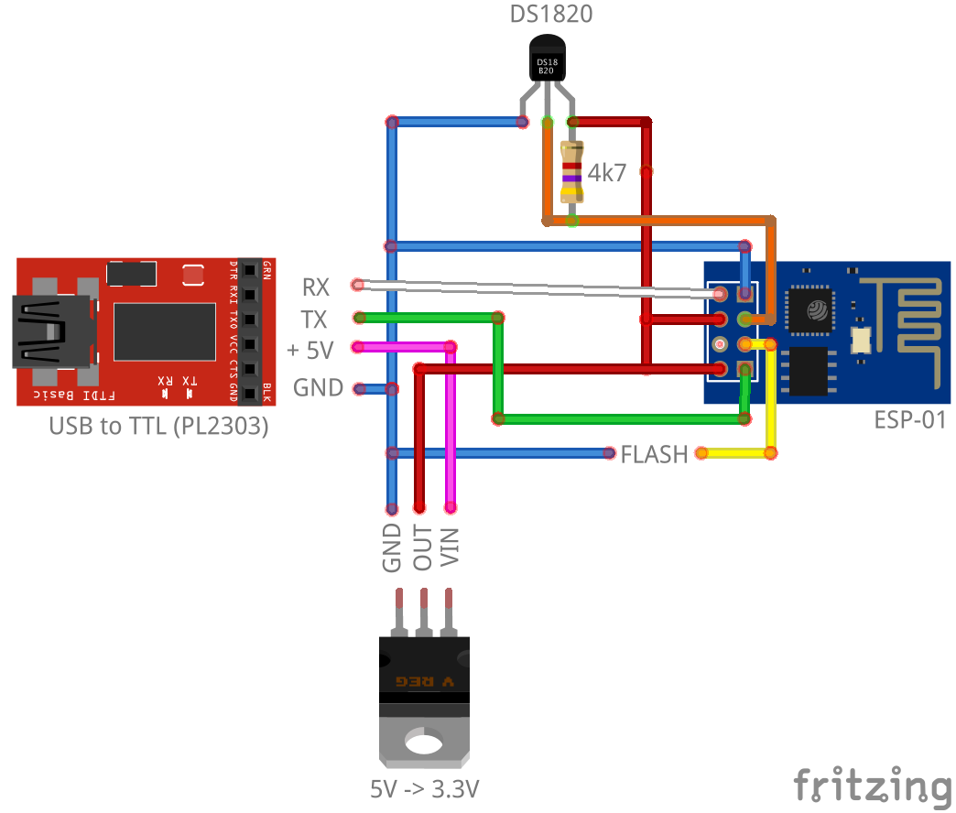
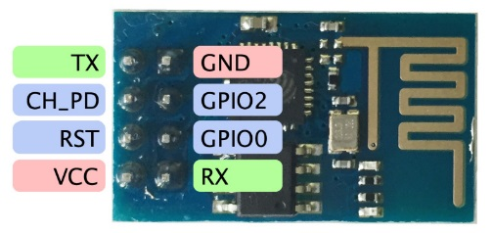
Connection | ESP-01

Slide 9
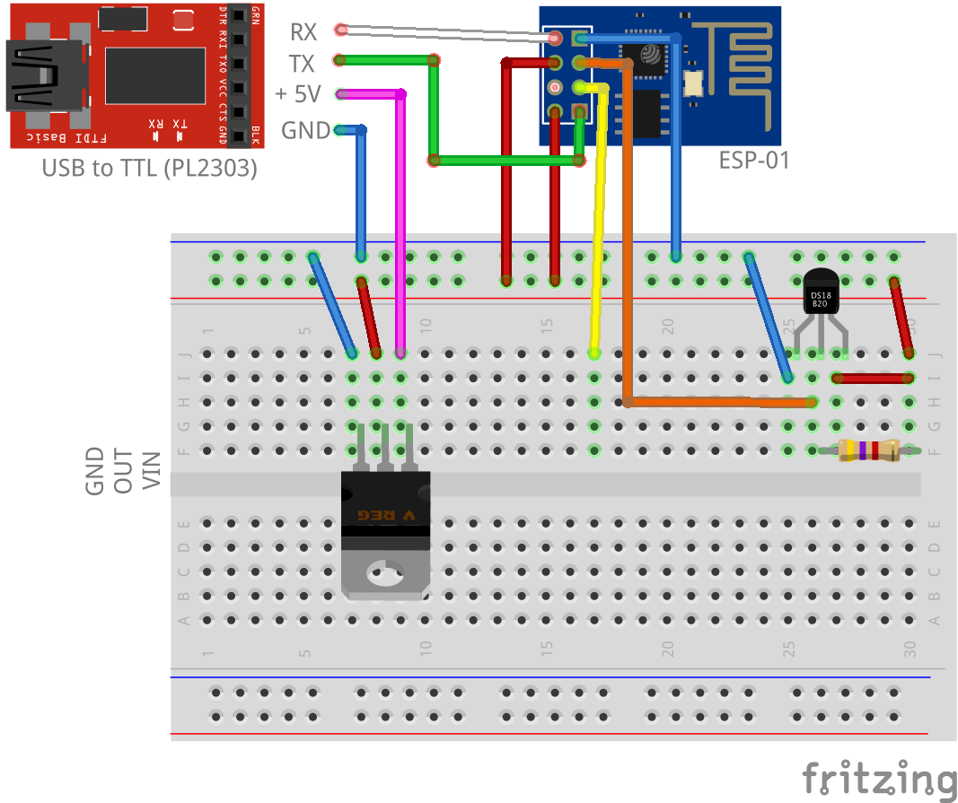
Connection | ESP-01

Slide 10
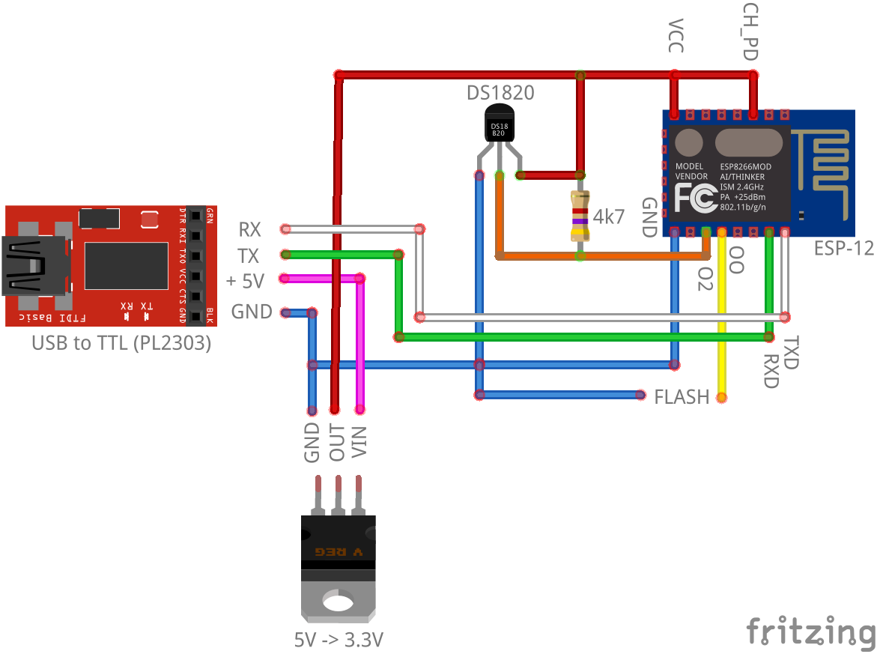
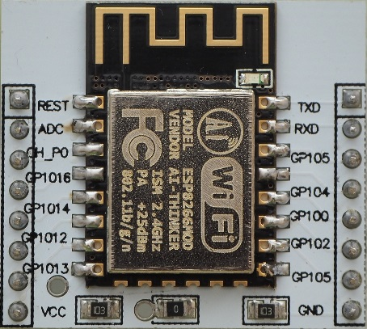
Connection | ESP-12

Slide 11
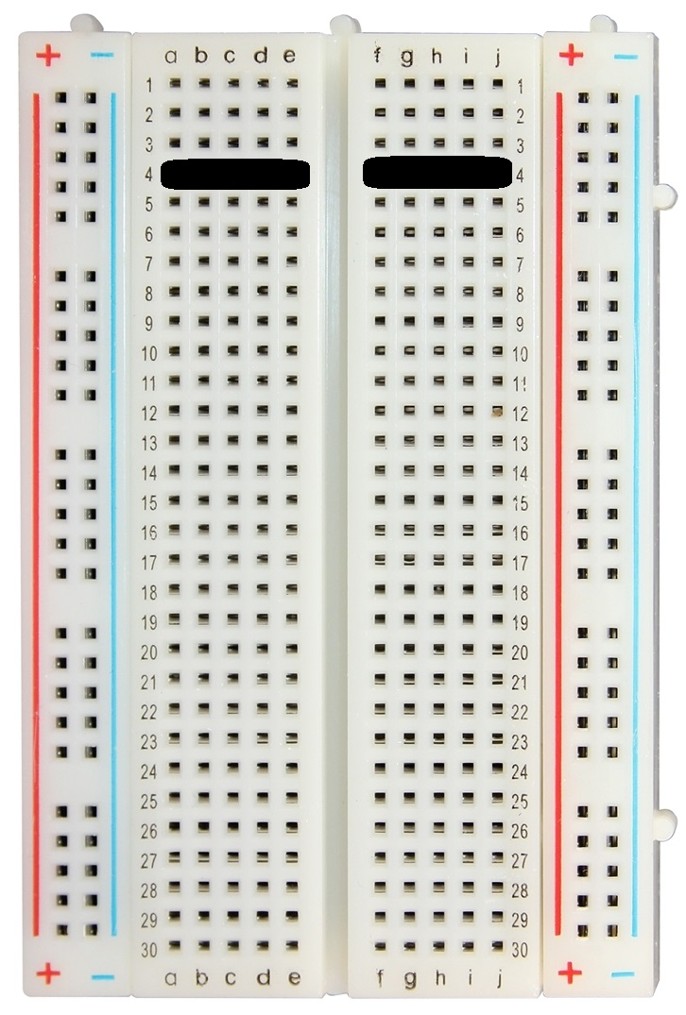
Breadboard
+/- are connected vertically.
+/- from one side is NOT connected to other side.
A-E and F-J are connected horizontally.
A-E is NOT connected to F-J.
Connection example on 4th line

Slide 12
Get Started on Windows
Install USB->Serial driver
http://www.prolific.com.tw/US/ShowProduct.aspx?p_id=225&pcid=41
Build firmware
https://nodemcu-build.com/
Select: file, GPIO, HTTP, net, node, 1-Wire, timer, UART, WiFi
Install python 2.7.x
https://www.python.org/downloads/
Install esptool.py
pip install esptool

Slide 13
Flash Firmware
Connect GPIO-00 to GND
Connect USB-to-Serial device to PC
Find COM port number
Go to Device Manager -> Ports
Flash firmware
esptool.py --port <serial-port-of-ESP8266> write_flash -fm qio 0x00000 <nodemcu-firmware>.bin
Disconnect USB-to-Serial device from PC
Disconnect GPIO-00 from GND

Slide 14
Upload a Program
Lua Loader
http://benlo.com/esp8266/
Connect USB-to-Serial device
Connect Lua Loader
Set WiFi
Upload a program
Run the program

Slide 15
Create Chart
Register on: https://thingspeak.com/
Create New Channel
Name – e.g. esp8266
Field 1 – e.g. temperature
Find your Write API key to use it in the ESP 8266.
Send the value:
http://api.thingspeak.com/update?key=<API key>&field1=<value>

Slide 16
Other Devices
DHT21 – temperature and humidity sensor
HC-SR04 – ultrasonic distance measuring
HC-SR501 – motion sensor detector
OLED or Nokia 5110 display
Addressable led strips
Servos
…

Slide 17
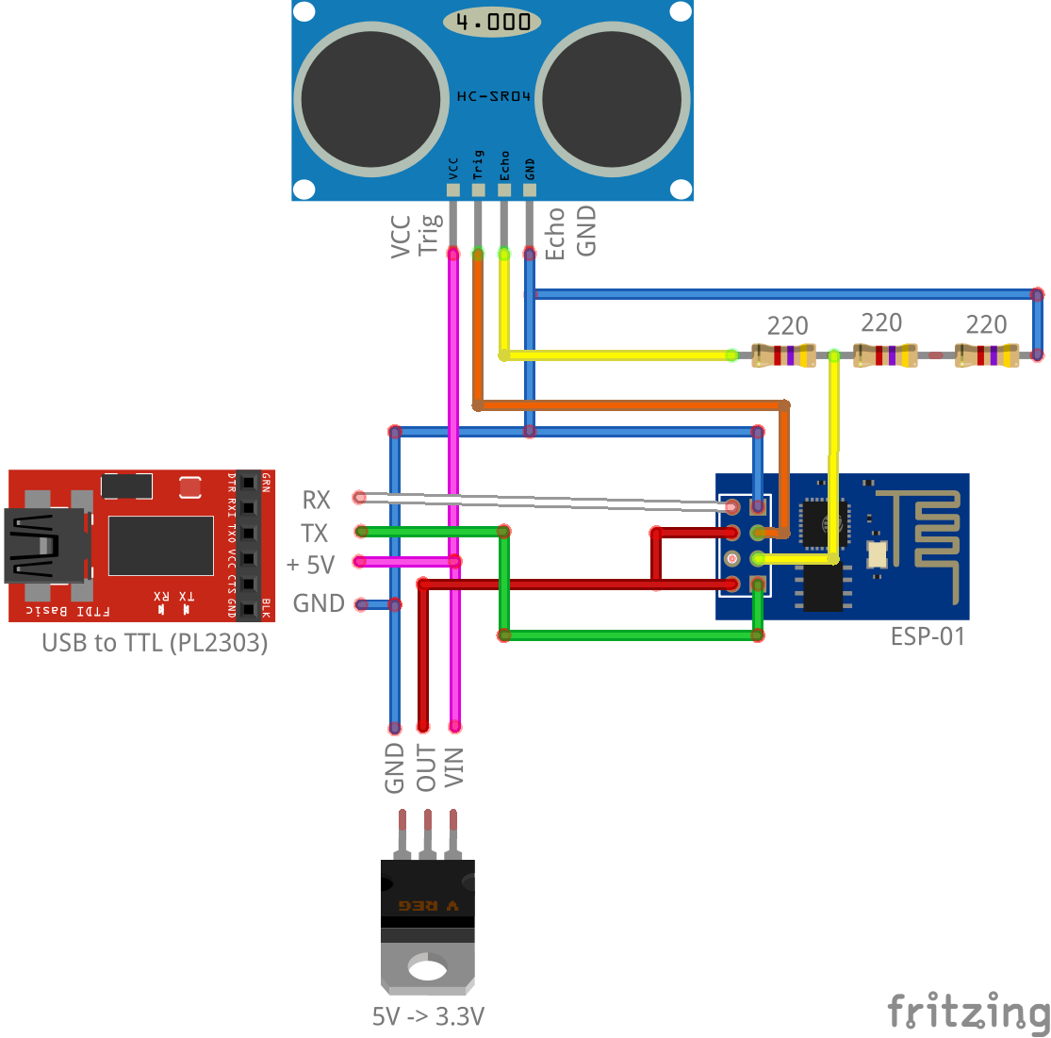
HC-SR04 – Ultrasonic Distance Measuring
HC-SR04 requires 5V power supply
Use voltage divider to connect ECHO to ESP

Slide 18
Documentation
Node MCU
http://nodemcu.readthedocs.io/en/master/en/
Contains information about
Building
Flashing
Modules
…

Slide 19
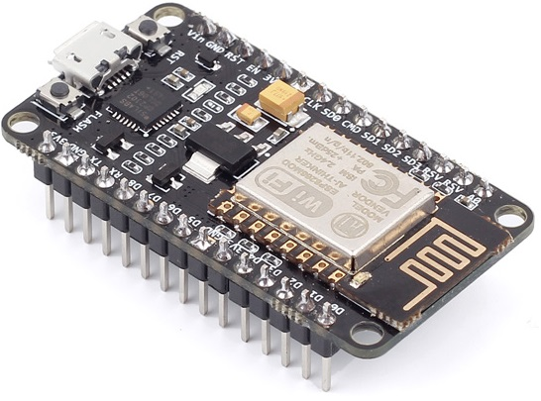
Node MCU Development Kit
USB-to-Serial + ESP 8266
Easy to put in the breadboard
Whole device is unusable when ESP dies
E.g. when you reach max number of writes

Slide 20
Get Started on Mac OS X
Tutorial
https://github.com/nodemcu/nodemcu-devkit/wiki/Getting-Started-on-OSX
Install driver
Install ESPlorer
Install python
Install esptool
Driver:
http://www.prolific.com.tw/US/ShowProduct.aspx?p_id=229&pcid=41

Slide 21
Arduino IDE
Install ESP 8266 support into Arduino IDE:
https://github.com/esp8266/Arduino
Build in + external libraries
https://github.com/esp8266/Arduino/blob/master/doc/libraries.md

Slide 22
My GitHub
https://github.com/apolo-11/esp8266

Slide 23
Questions?

